Slide 1






R as Interface for Analysis in Databases
2020-09-01
Data Scientist at NetApp
Bryan Shalloway
@brshallo
www.bryanshalloway.com/

Slide 2

Former High School Math teacher and then Education Analyst
MS Advanced Analytics NC State
Data Scientist at NetApp in Customer Support and Sales (since July 2017)
#rstats and opensource enthusiast
Not an Enterprise Architect, Database Administrator, etc.

Slide 3


Slide 4
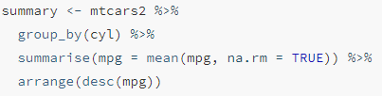
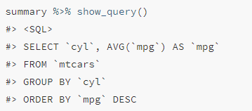
Translating R (dplyr) code to SQL
Why:
Can make analysts more efficient
Minimal set-up for supporting analysts who want to deploy R code or model in production environments

Slide 5

Common parts of Data Science
Notes:
Image is from R for Data Science textbook

Slide 6
Historical Modular tools
Tools like:
SQL, Alteryx, Power Query, ...
BI Tools:
Tableau, Power BI, …
Communication tools:
Word, Adobe, HTML
Scripting / automation:
Macros, functions, other programming languages…
Statistical and modeling tools:
SPSS, SAS, STATA, …

Slide 7
Shift towards doing it all
Advantages with R, Python, and scripting approach:
Can do all (or many) of these steps in a single tool during investigation (reduces cognitive load)
Scripting facilitates more flexible operations and advantages of opensource
Modular packages rather than modular tools

Slide 8
Historical Modular tools
readxl, rvest, xml2, DBI, odbc, …
ggplot2, ggforce, shiny, …
rmarkdown, knitr, notebooks, …
purrr, drake, magrittr …
caret, parsnip, fable, broom, …
Advantages with R, Python, and scripting approach:
Can do all (or many) of these steps in a single tool during investigation (reduces cognitive load)
Scripting facilitates more flexible operations and advantages of opensource
Modular packages rather than modular tools

Slide 9
Example of tidyverse style R code
R is a highly expressive and intuitive language for performing parts of Data Science

Slide 10
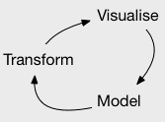
Some things about R
“<-” is R’s assignment operator… (“=“ also works)
Iris2 <- iris %>%
select(-Sepal.Length) %>%
mutate_if(.predicate = is.numeric,
.funs = log)
“.” can just be another character in a name…
“%>%” are R’s pipes… i.e. “and then”
For ggplot2 “pipes” are…
+
Notes:
First though, a few peculiar things about R that I want to mention that may look a little funny compared to other languages…
One is that when you see this greater than-minus sign, know that that is R’s assignment operator R, you also could just use an equals sign generally…
Second is that periods are not always special characters and can serve as just parts of a name. So here “Sepal.Length” represents the name of a variable in this dataset. When next to letters, the period does not do anything special and can just be looked at as a regular character.
Third is that the percent-greater than-percent sign is R’s version of a pipe. What it does is it says take what you have up to this point and pass or pipe it into the next step or function. Using pipes is one of the hallmarks of the “tidyverse”, as it makes long chains of composite functions easy to follow.
One quirk is that for ggplot2, the visualization package I use in these examples, it uses the “+” sign as a pipe. So you’ll see at the end of the line these + signs…

Slide 11
gapminder
# A tibble: 1,704 x 6
country continent
year lifeExp
pop gdpPercap
<fct> <fct>
<int>
<dbl>
28.8 8425333
<int>
<dbl> 779.
821.
853.
836.
740.
786.
978.
852.
649.
635.
Afghanistan Asia
Afghanistan Asia
Afghanistan Asia
Afghanistan Asia
Afghanistan Asia
Afghanistan Asia
Afghanistan Asia
Afghanistan Asia
1952
1957
1962
1967
1972
1977
1982
1987
1992
30.3 9240934
32.0 10267083
34.0 11537966
36.1 13079460
38.4 14880372
39.9 12881816
40.8 13867957
9 Afghanistan Asia
41.7 16317921
41.8 22227415
10 Afghanistan Asia 1997
# ... with 1,694 more rows
https://github.com/brshallo/flipbookr-gifs-examples

Slide 12
gapminder %>%
# A tibble: 1,704 x 4 country continent
select(-c(pop, gdpPercap))
year lifeExp
 | <fct> | <fct> | <int> | <dbl>
1 | Afghanistan | Asia | 1952 | 28.8
2 | Afghanistan | Asia | 1957 | 30.3
3 | Afghanistan | Asia | 1962 | 32.0
4 | Afghanistan | Asia | 1967 | 34.0
5 | Afghanistan | Asia | 1972 | 36.1
6 | Afghanistan | Asia | 1977 | 38.4
7 | Afghanistan | Asia | 1982 | 39.9
8 | Afghanistan | Asia | 1987 | 40.8
9 | Afghanistan | Asia | 1992 | 41.7
10 | Afghanistan | Asia | 1997 | 41.8
# ... with 1,694 more rows
https://github.com/brshallo/flipbookr-gifs-examples

Slide 13
gapminder %>%
select(-c(pop, gdpPercap)) %>%
# A tibble: 1,704 x 4
# Groups: country, continent [142] country continent year lifeExp
group_by(country, continent)
 | <fct> | <fct> | <int> | <dbl>
1 | Afghanistan | Asia | 1952 | 28.8
2 | Afghanistan | Asia | 1957 | 30.3
3 | Afghanistan | Asia | 1962 | 32.0
4 | Afghanistan | Asia | 1967 | 34.0
5 | Afghanistan | Asia | 1972 | 36.1
6 | Afghanistan | Asia | 1977 | 38.4
7 | Afghanistan | Asia | 1982 | 39.9
8 | Afghanistan | Asia | 1987 | 40.8
9 | Afghanistan | Asia | 1992 | 41.7
10 | Afghanistan | Asia | 1997 | 41.8
# ... with 1,694 more rows
https://github.com/brshallo/flipbookr-gifs-examples

Slide 14
gapminder %>%
select(-c(pop, gdpPercap)) %>% group_by(country, continent) %>%
# A tibble: 142 x 3
# Groups: country, continent [142]
country continent data
nest()
<fct> <fct>
<list>
<tibble [12 x 2]>
<tibble [12 x 2]>
<tibble [12 x 2]>
<tibble [12 x 2]>
<tibble [12 x 2]>
<tibble [12 x 2]>
<tibble [12 x 2]>
<tibble [12 x 2]>
<tibble [12 x 2]>
<tibble [12 x 2]>
1 Afghanistan Asia
Albania
Algeria
Angola
Argentina
Australia
Austria
Bahrain
Bangladesh
Europe
Africa Africa Americas Oceania Europe Asia Asia
10 Belgium Europe
# ... with 132 more rows
https://github.com/brshallo/flipbookr-gifs-examples

Slide 15
gapminder %>%
select(-c(pop, gdpPercap)) %>% group_by(country, continent) %>% nest() %>%
# A tibble: 142 x 5
# Groups: country, continent [142]
country | continent | data | model |  |  |  | results
<fct> | <fct> | <list> | <list> |  |  |  | <list>
1 Afghanistan | Asia | <tibble | [12 | x | 2]> | <lm> | <tibble
2 Albania | Europe | <tibble | [12 | x | 2]> | <lm> | <tibble
3 Algeria | Africa | <tibble | [12 | x | 2]> | <lm> | <tibble
4 Angola | Africa | <tibble | [12 | x | 2]> | <lm> | <tibble
5 Argentina | Americas | <tibble | [12 | x | 2]> | <lm> | <tibble
6 Australia | Oceania | <tibble | [12 | x | 2]> | <lm> | <tibble
7 Austria | Europe | <tibble | [12 | x | 2]> | <lm> | <tibble
8 Bahrain | Asia | <tibble | [12 | x | 2]> | <lm> | <tibble
9 Bangladesh | Asia | <tibble | [12 | x | 2]> | <lm> | <tibble
10 Belgium # ... with 132 | Europe more rows | <tibble | [12 | x | 2]> | <lm> | <tibble
mutate(model = map(data,
~lm(lifeExp ~ year, data = .x)), results = map(model, broom::glance))
[1 x
[1 x
[1 x
[1 x
[1 x
[1 x
[1 x
[1 x
[1 x
[1 x
https://github.com/brshallo/flipbookr-gifs-examples

Slide 16
gapminder %>%
select(-c(pop, gdpPercap)) %>% group_by(country, continent) %>% nest() %>%
mutate(model = map(data,
~lm(lifeExp ~ year, data = .x)), results = map(model, broom::glance)) %>%
# A tibble: 142 x 15
# Groups: country, continent [142]
country |  | continent | data | model r.squared |  | adj.r.squared | sigma
<fct> |  | <fct> | <lis> | <lis> <dbl> |  | <dbl> | <dbl>
1 Afghan~ Asia |  |  | <tib~ | <lm> | 0.948 | 0.942 | 1.22
2 | Albania | Europe | <tib~ | <lm> | 0.911 | 0.902 | 1.98
3 | Algeria | Africa | <tib~ | <lm> | 0.985 | 0.984 | 1.32
4 | Angola | Africa | <tib~ | <lm> | 0.888 | 0.877 | 1.41
5 | Argent~ | Americas | <tib~ | <lm> | 0.996 | 0.995 | 0.292
6 | Austra~ | Oceania | <tib~ | <lm> | 0.980 | 0.978 | 0.621
7 | Austria | Europe | <tib~ | <lm> | 0.992 | 0.991 | 0.407
8 | Bahrain | Asia | <tib~ | <lm> | 0.967 | 0.963 | 1.64
9 | Bangla~ | Asia | <tib~ | <lm> | 0.989 | 0.988 | 0.977
10 | Belgium | Europe | <tib~ | <lm> | 0.995 | 0.994 | 0.293
unnest(results)
# ... with 132 more rows, and 5 more variables: logLik <dbl>, A # deviance <dbl>, df.residual <int>
https://github.com/brshallo/flipbookr-gifs-examples

Slide 17

gapminder %>%
select(-c(pop, gdpPercap)) %>% group_by(country, continent) %>% nest() %>%
mutate(model = map(data,
~lm(lifeExp ~ year, data = .x)), results = map(model, broom::glance)) %>%
unnest(results) %>%
ggplot()
https://github.com/brshallo/flipbookr-gifs-examples

Slide 18
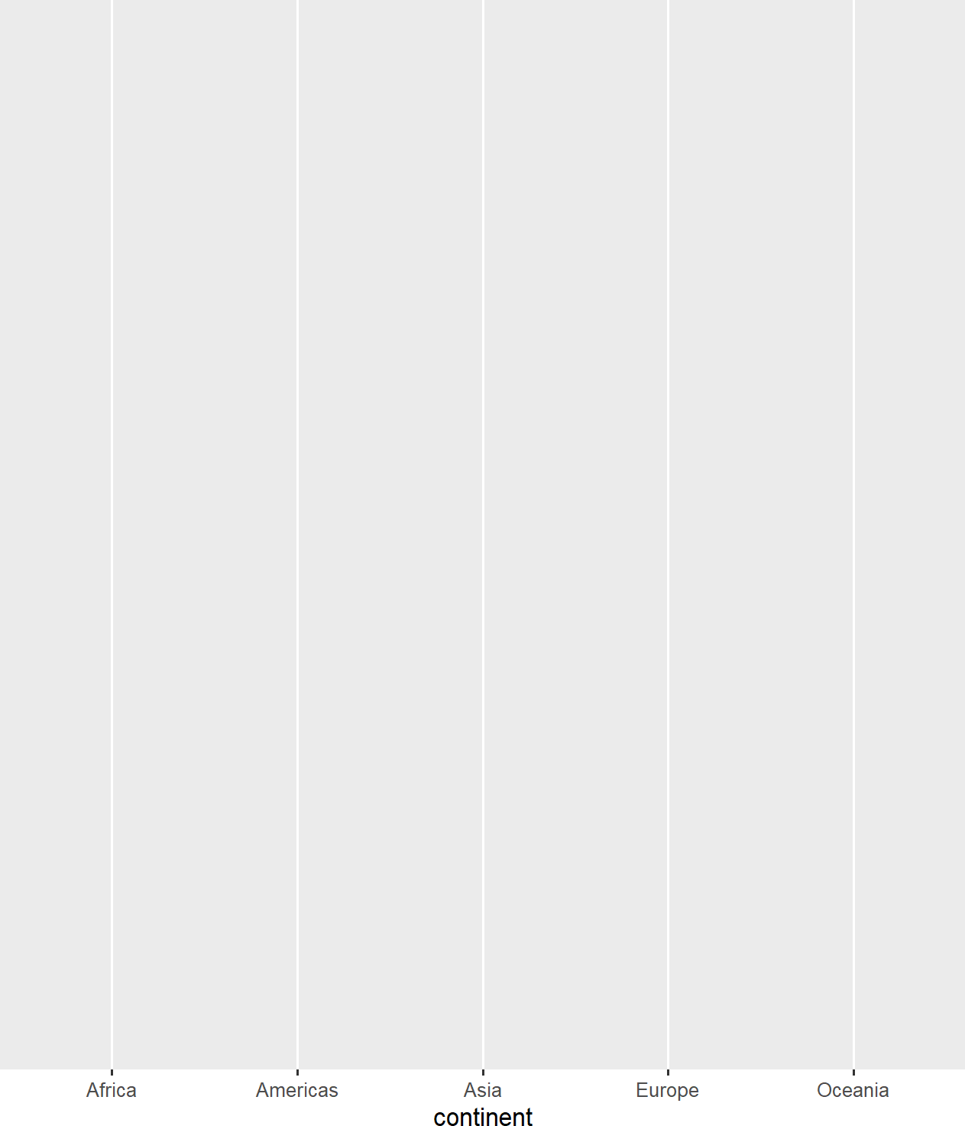
gapminder %>%
select(-c(pop, gdpPercap)) %>% group_by(country, continent) %>% nest() %>%
mutate(model = map(data,
~lm(lifeExp ~ year, data = .x)), results = map(model, broom::glance)) %>%
unnest(results) %>% ggplot()+
aes(x = continent)
https://github.com/brshallo/flipbookr-gifs-examples

Slide 19
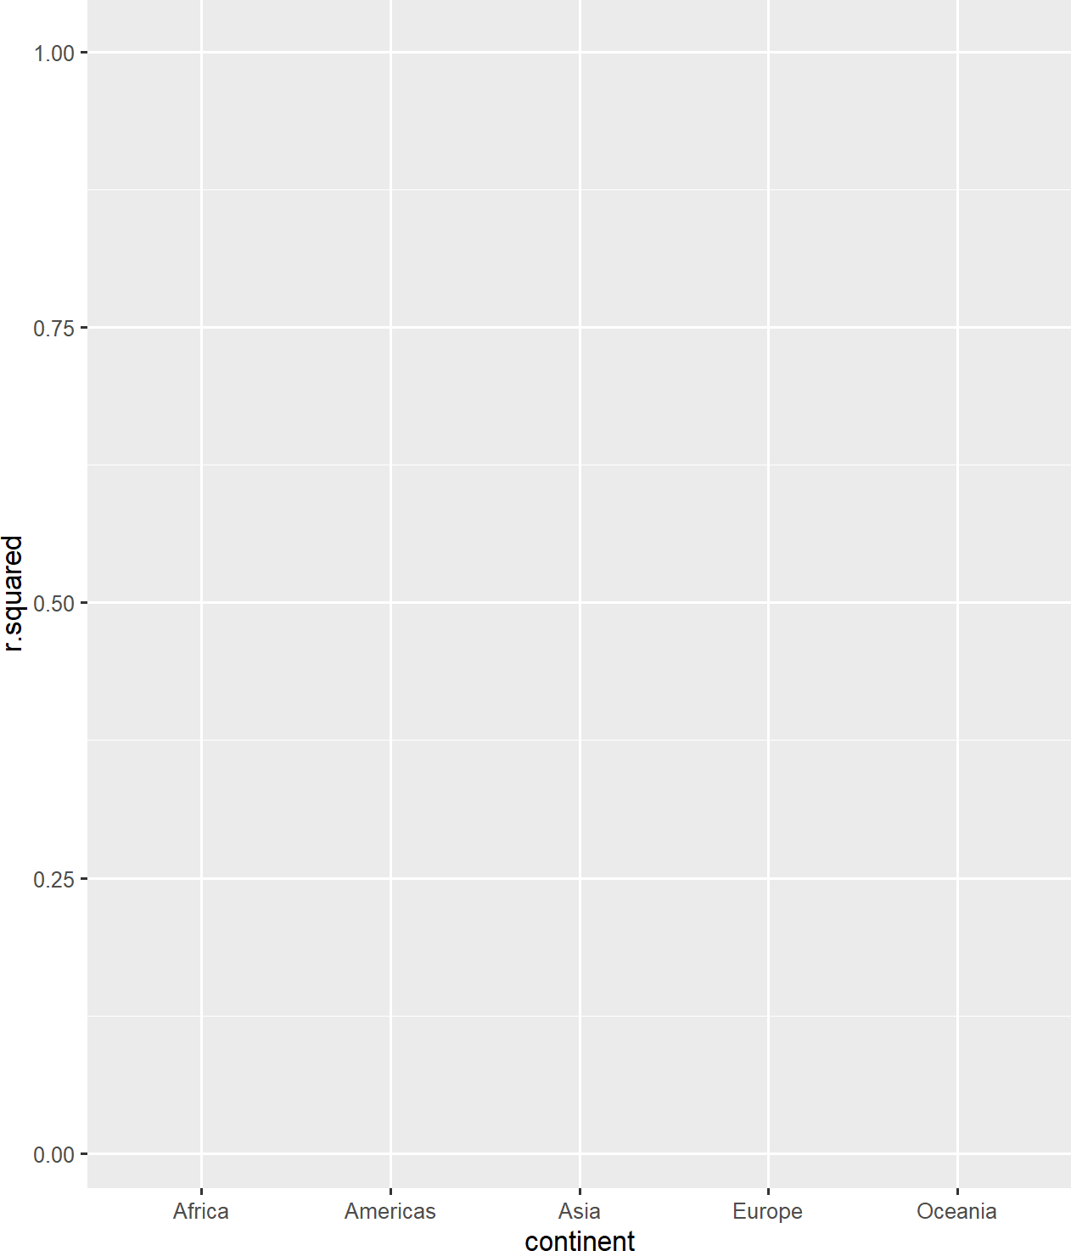
gapminder %>%
select(-c(pop, gdpPercap)) %>% group_by(country, continent) %>% nest() %>%
mutate(model = map(data,
~lm(lifeExp ~ year, data = .x)), results = map(model, broom::glance)) %>%
unnest(results) %>% ggplot()+
aes(x = continent)+
aes(y = r.squared)
https://github.com/brshallo/flipbookr-gifs-examples

Slide 20
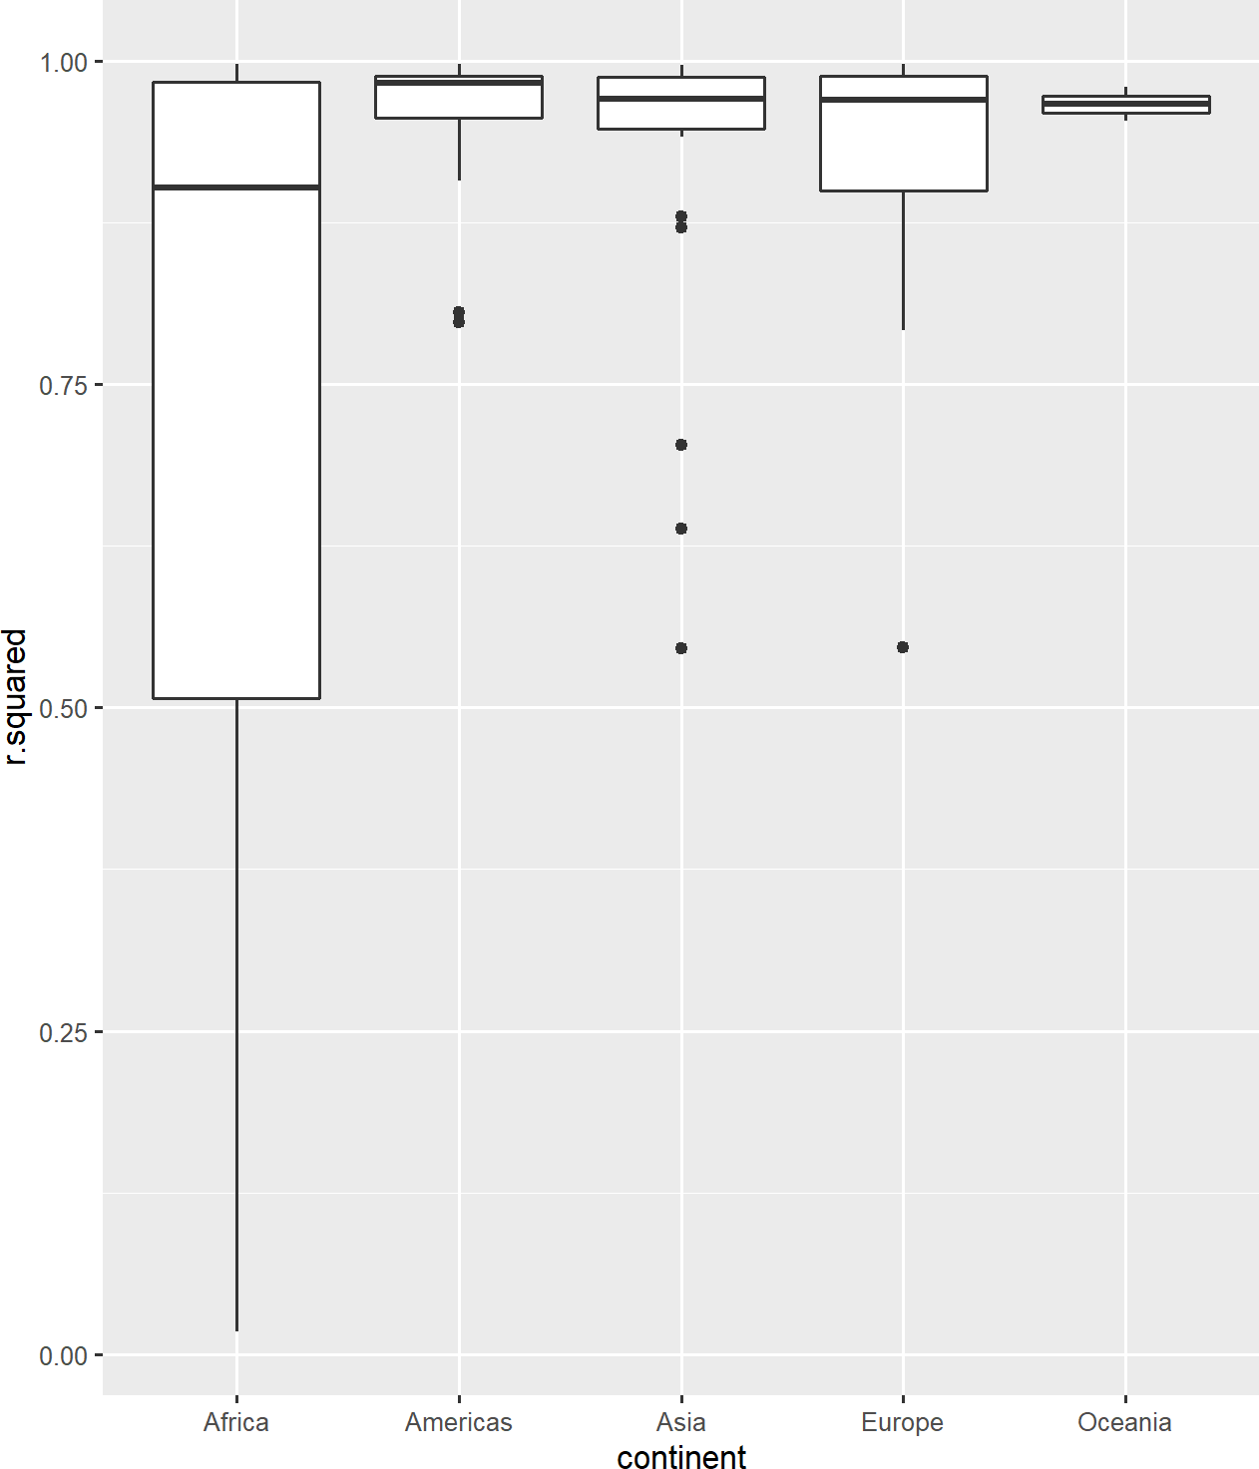
gapminder %>%
select(-c(pop, gdpPercap)) %>% group_by(country, continent) %>% nest() %>%
mutate(model = map(data,
~lm(lifeExp ~ year, data = .x)), results = map(model, broom::glance)) %>%
unnest(results) %>% ggplot()+
aes(x = continent)+ aes(y = r.squared)+
geom_boxplot()
https://github.com/brshallo/flipbookr-gifs-examples

Slide 21
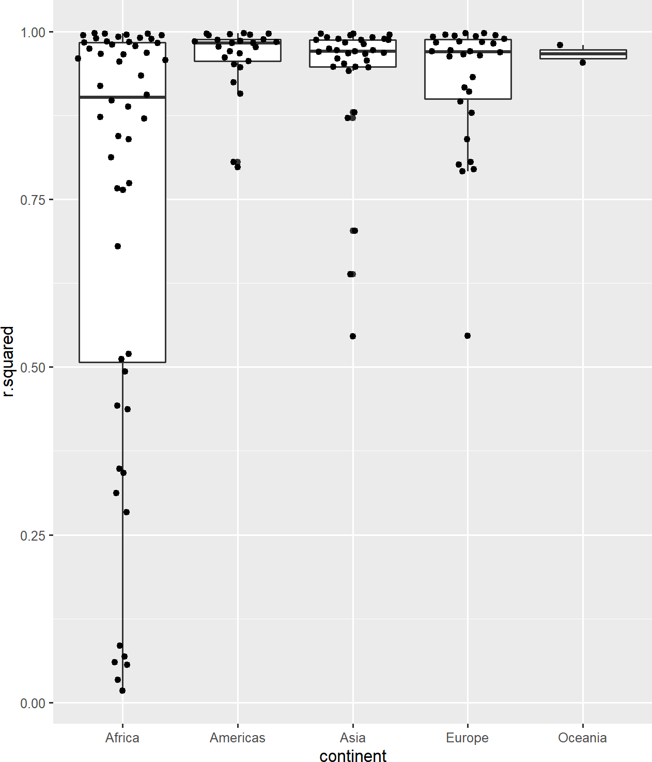
gapminder %>%
select(-c(pop, gdpPercap)) %>% group_by(country, continent) %>% nest() %>%
mutate(model = map(data,
~lm(lifeExp ~ year, data = .x)), results = map(model, broom::glance)) %>%
unnest(results) %>% ggplot()+
aes(x = continent)+ aes(y = r.squared)+ geom_boxplot()+
ggbeeswarm::geom_quasirandom()
https://github.com/brshallo/flipbookr-gifs-examples

Slide 22
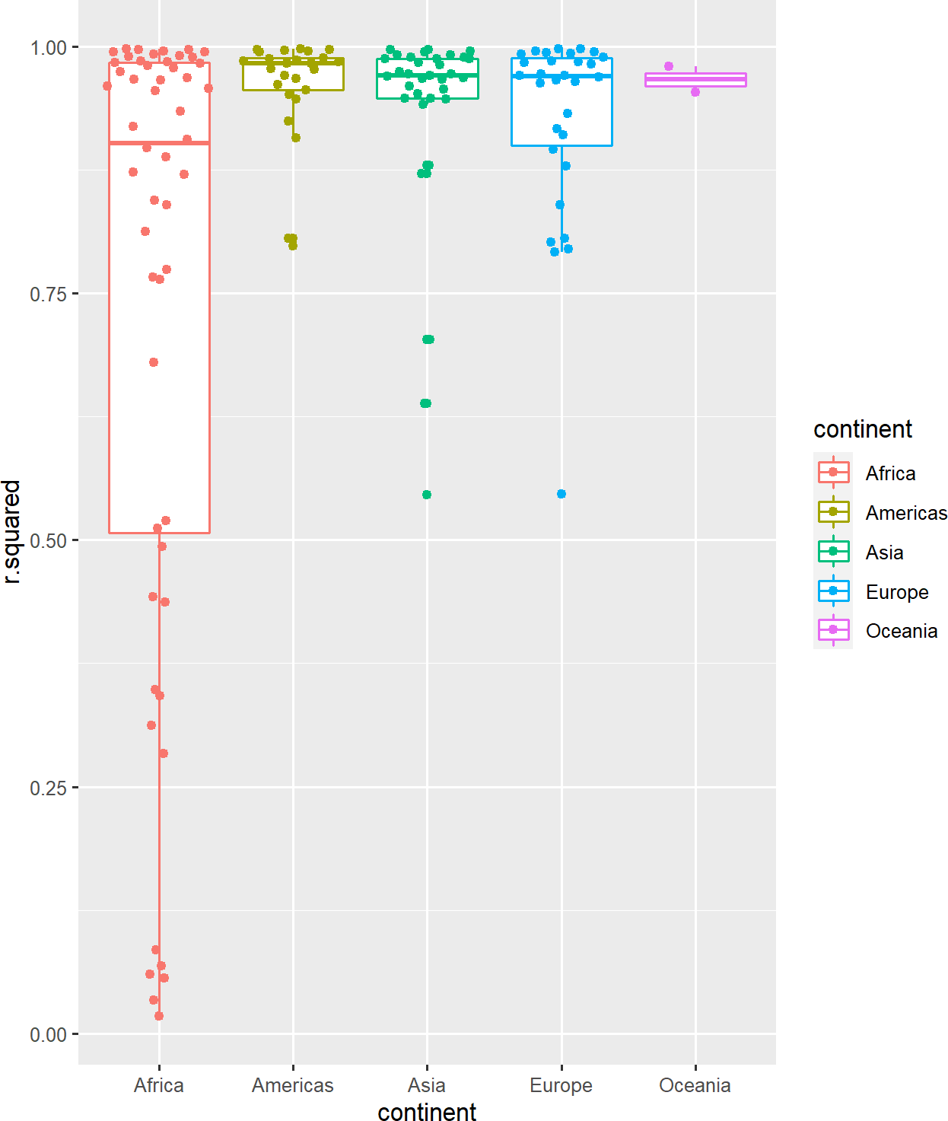
gapminder %>%
select(-c(pop, gdpPercap)) %>% group_by(country, continent) %>% nest() %>%
mutate(model = map(data,
~lm(lifeExp ~ year, data = .x)), results = map(model, broom::glance)) %>%
unnest(results) %>% ggplot()+
aes(x = continent)+ aes(y = r.squared)+ geom_boxplot()+
ggbeeswarm::geom_quasirandom()+
aes(colour = continent)
https://github.com/brshallo/flipbookr-gifs-examples

Slide 23
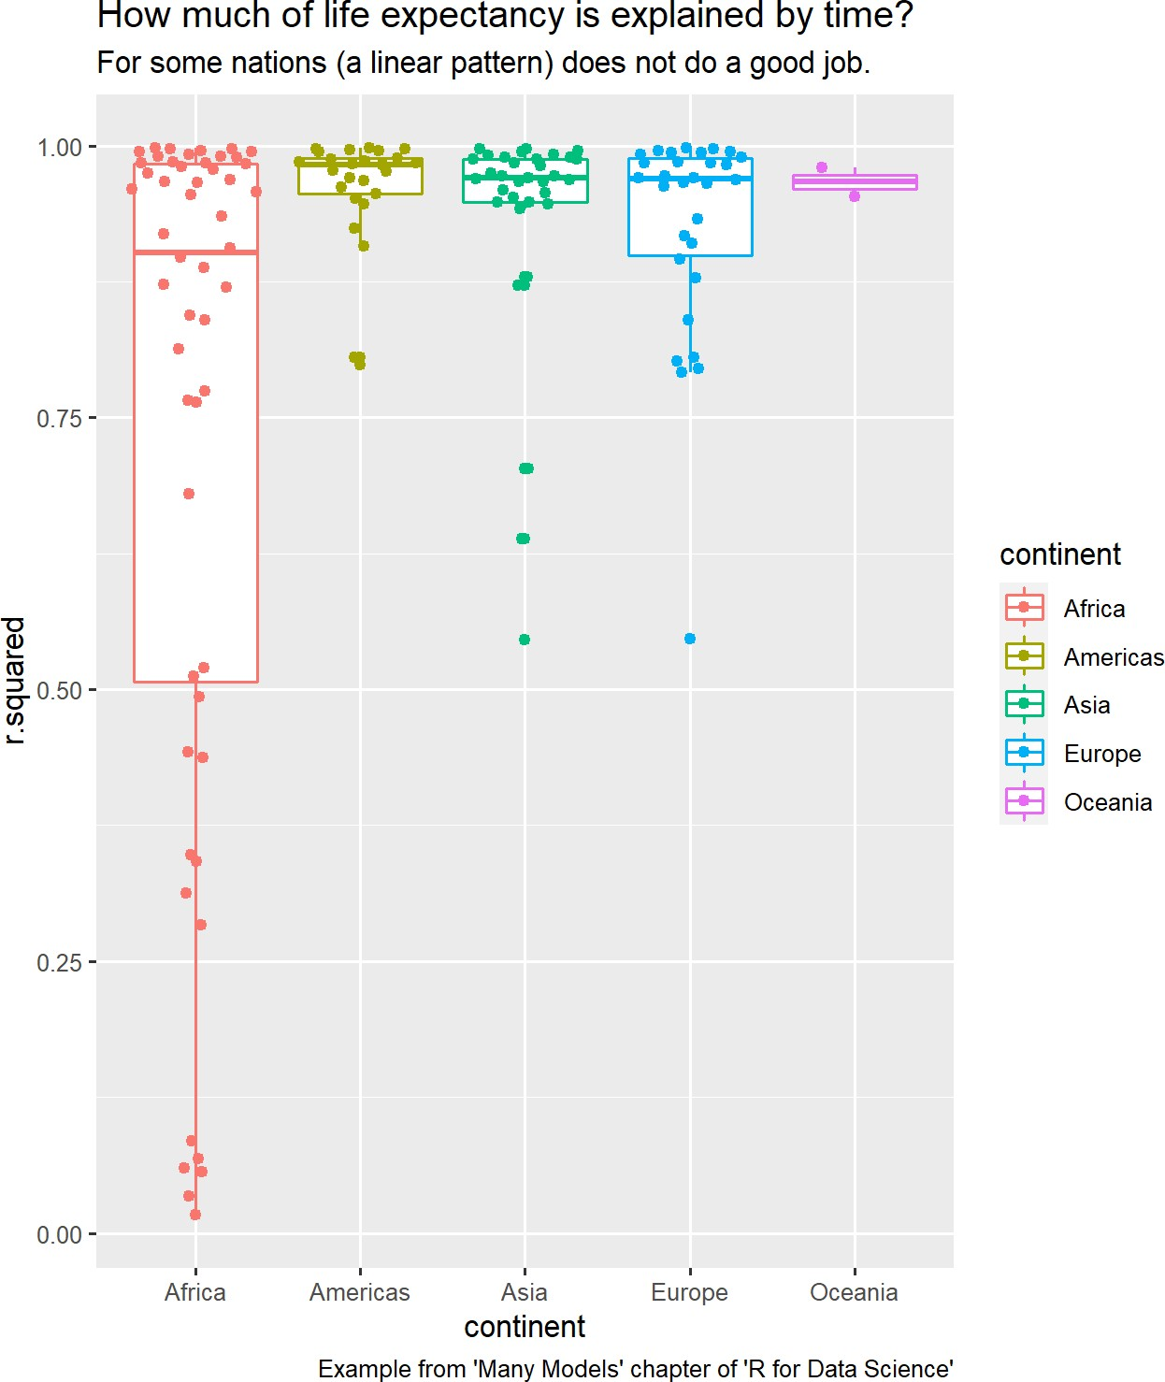
gapminder %>%
select(-c(pop, gdpPercap)) %>% group_by(country, continent) %>% nest() %>%
mutate(model = map(data,
~lm(lifeExp ~ year, data = .x)), results = map(model, broom::glance)) %>%
unnest(results) %>% ggplot()+
aes(x = continent)+ aes(y = r.squared)+ geom_boxplot()+
ggbeeswarm::geom_quasirandom()+ aes(colour = continent)+
labs(title = "How much of life expectancy is explain subtitle = "For some nations (a linear pattern) caption = "Example from 'Many Models' chapter o
https://github.com/brshallo/flipbookr-gifs-examples

Slide 24
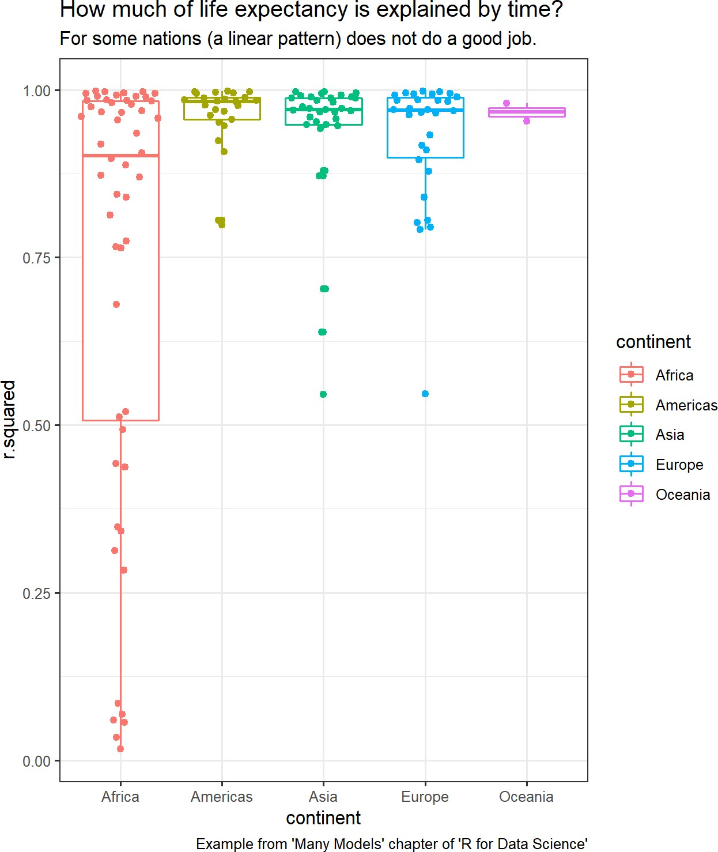
gapminder %>%
select(-c(pop, gdpPercap)) %>% group_by(country, continent) %>% nest() %>%
mutate(model = map(data,
~lm(lifeExp ~ year, data = .x)), results = map(model, broom::glance)) %>%
unnest(results) %>% ggplot()+
aes(x = continent)+ aes(y = r.squared)+ geom_boxplot()+
ggbeeswarm::geom_quasirandom()+ aes(colour = continent)+
labs(title = "How much of life expectancy is explain subtitle = "For some nations (a linear pattern) caption = "Example from 'Many Models' chapter o
theme_bw()
https://github.com/brshallo/flipbookr-gifs-examples

Slide 25
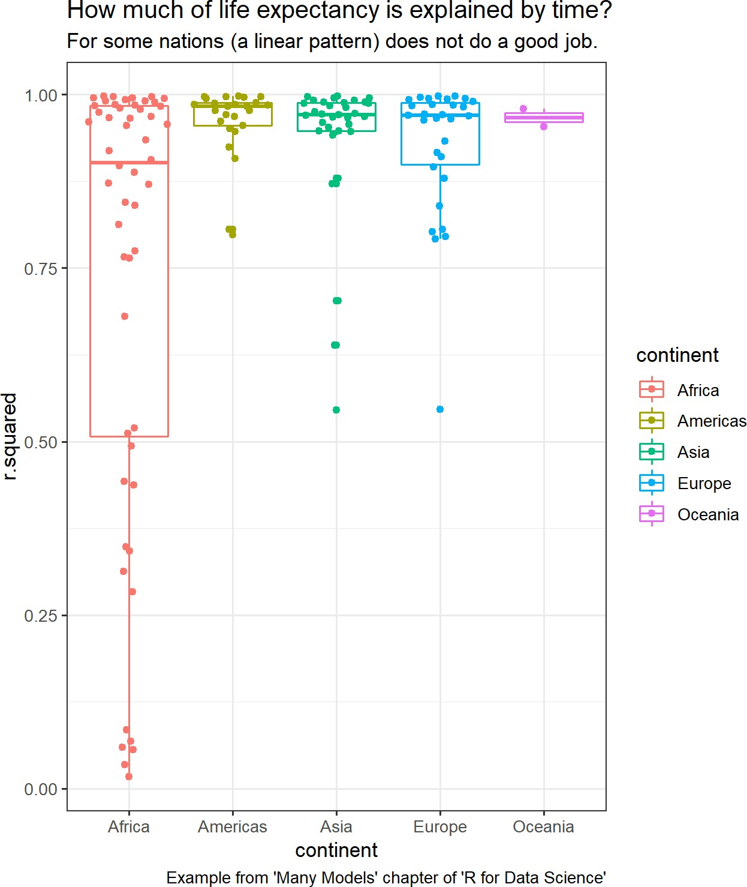
gapminder %>%
select(-c(pop, gdpPercap)) %>% group_by(country, continent) %>% nest() %>%
mutate(model = map(data,
~lm(lifeExp ~ year, data = .x)), results = map(model, broom::glance)) %>%
unnest(results) %>% ggplot()+
aes(x = continent)+ aes(y = r.squared)+ geom_boxplot()+
ggbeeswarm::geom_quasirandom()+ aes(colour = continent)+
labs(title = "How much of life expectancy is explain subtitle = "For some nations (a linear pattern) caption = "Example from 'Many Models' chapter o
theme_bw()+
theme(text = element_text(size = 11.5))
https://github.com/brshallo/flipbookr-gifs-examples

Slide 26
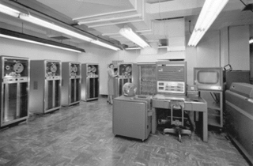
How R handles being a niche language
R may not be the ideal compute environment
Technology provider may not directly create an API for R
History of R:
R’s precursor, S, was written as an interface to Fortran for statisticians
Works well as an interface:
Have interfaces in python (reticulate), C++ (rcpp), curl, and many others
Today will be focused on interface with SQL
https://en.wikipedia.org/wiki/Fortran

Slide 27
We want data scientists to live in a world where technology is hidden from them, where you can use the R packages you know and love, and they “just work” …
-TheRinSpark

Slide 28

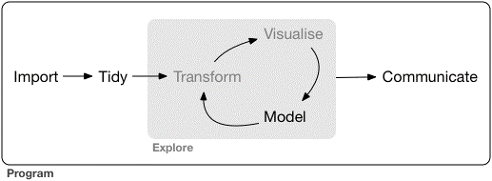
We want data scientists to live in a world where technology is hidden from them, where you can use the R packages you know and love, and they “just work” …
-TheRinSpark
SQL ENGINE

Slide 29


Slides from here on are taken from Rstudio Enterprise Architect, Edgar Ruiz presentations or from examples on websites he maintains

Slide 30
Traditional situation as an analyst

Slide 31


Current challenges
Option 1 - Save small pieces, analyze later
Neither option use the SQL engine
Small conduit
Option 2 –
Load a lot of data into memory
Note that sampling is also completely reasonable approach in many instances
https://rstudio.com/resources/webinars/best-practices-for-working-with-databases/

Slide 32
Ideally, analyze in-place
select sum(amount) from sales group by month
“total sales by month”
Returns a data.frame with 12 records
https://rstudio.com/resources/webinars/best-practices-for-working-with-databases/

Slide 33
Ideally, analyze in-place
select count() from sales where amount > 1000 group by month
“Number of sales over $1K by month”
Returns a data.frame with 12 records
https://rstudio.com/resources/webinars/best-practices-for-working-with-databases/

Slide 34

Ideally, analyze in-place
using R code, dplyr
dplyr writes the SQL query
select count() from sales where amount > 1000 group by month
“Number of sales over $1K by month”
sales %>%
filter(amount > 1000) %>%
group_by(month) %>%
tally()
Returns a data.frame with 12 records
https://rstudio.com/resources/webinars/best-practices-for-working-with-databases/

Slide 35
Ideally, analyze in-place
using dplyr
sales %>%
filter(amount > 1000) %>%
group_by(month) %>%
tally()
Use piped code (Modular & easy to read)
Push compute to the database
https://rstudio.com/resources/webinars/best-practices-for-working-with-databases/

Slide 36
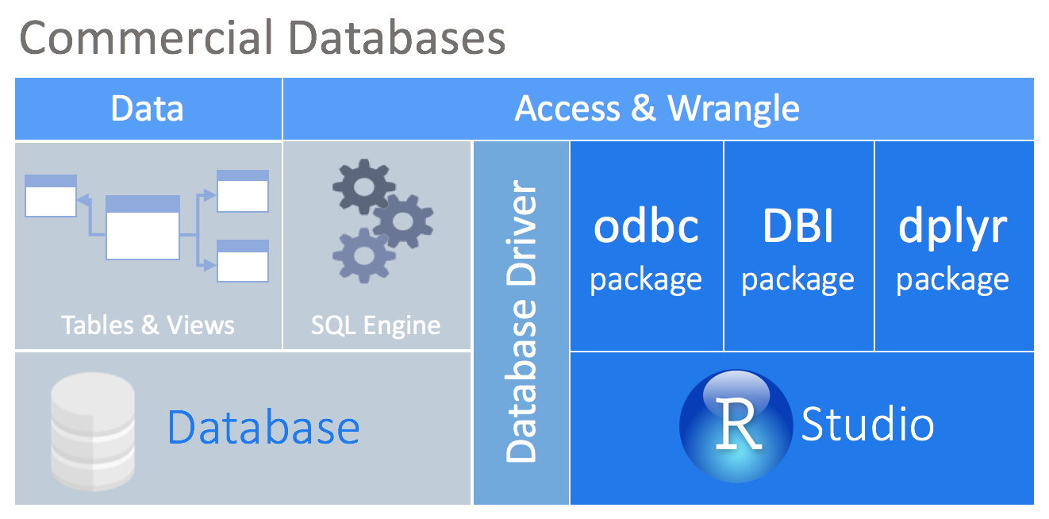
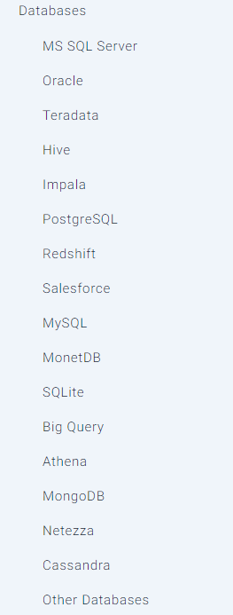
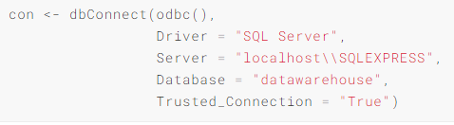
Bonus: differences between SQL dialects are automatically handled
https://db.rstudio.com/

Slide 37
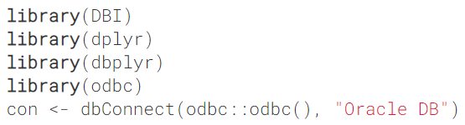
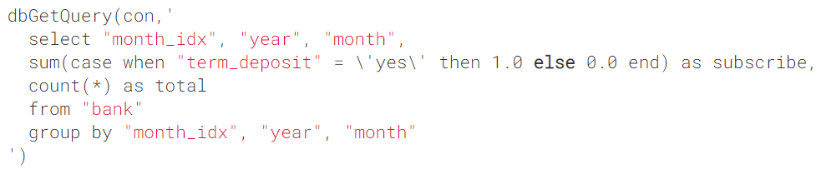
Example, query using DBI
https://db.rstudio.com/

Slide 38
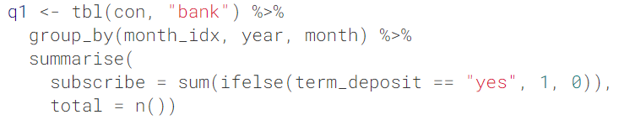
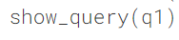
Example, query using dplyr
https://db.rstudio.com/

Slide 39
Best practices for visualizations

Slide 40
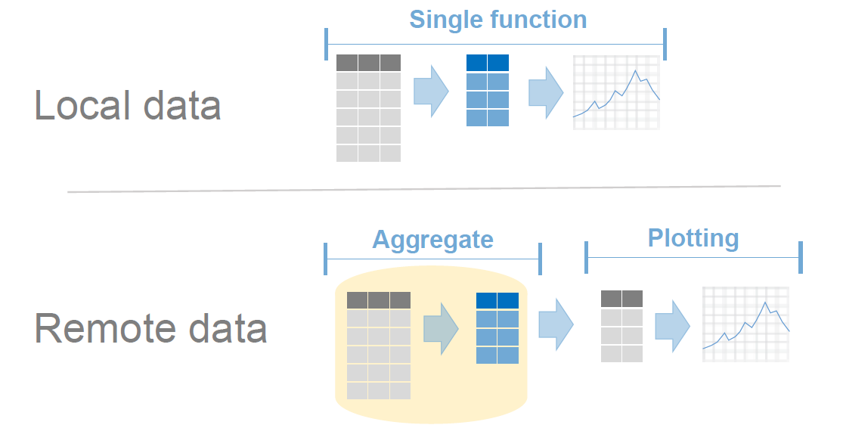
Aggregate in database, plot locally
https://github.com/edgararuiz/big-data-w-r

Slide 41
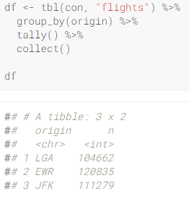
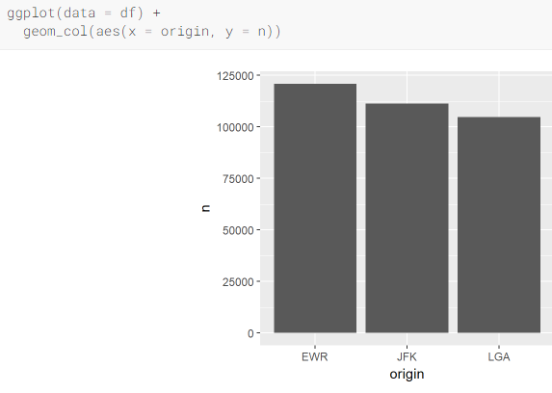
Do compute in SQL engine, return minimal
https://db.rstudio.com/
Notes:
https://db.rstudio.com/best-practices/visualization/

Slide 42
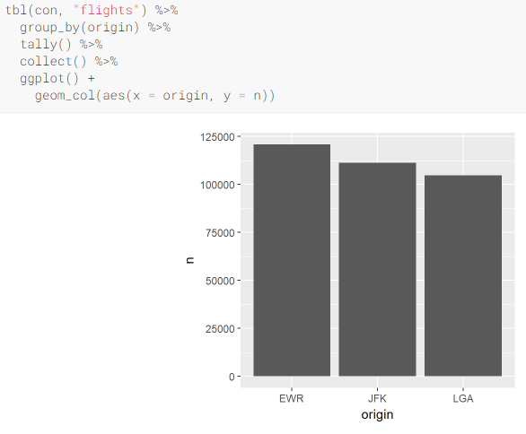
Do compute in SQL engine, return minimal
https://db.rstudio.com/
Notes:
https://db.rstudio.com/best-practices/visualization/

Slide 43
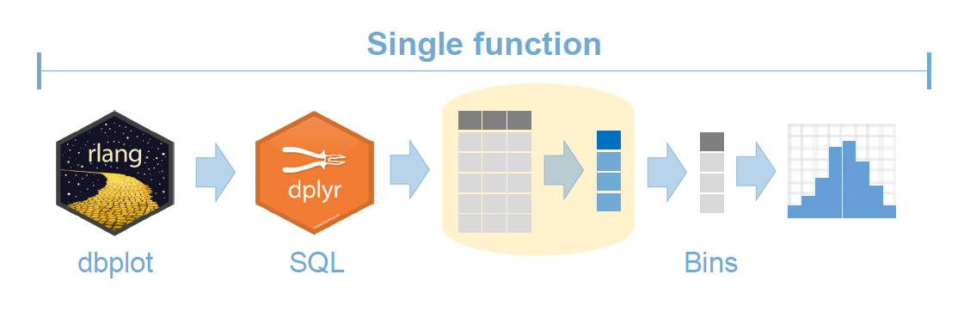
Convenience functions for histograms and raster plots… `dbplot` package
https://edgararuiz.github.io/dbplot/

Slide 44
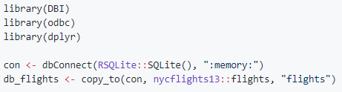
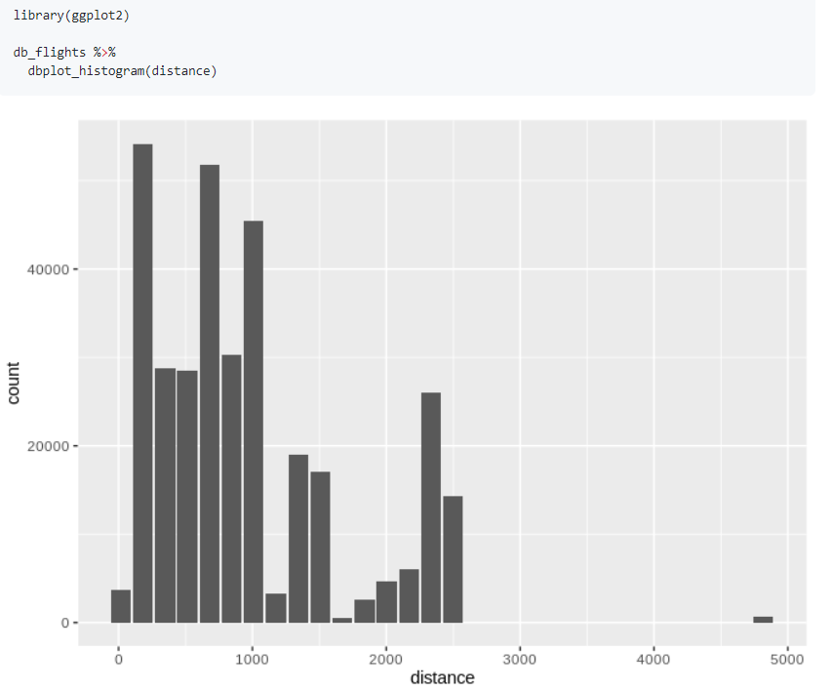
`dbplot` examples
Leverages `dplyr` to process the calculations of a plot inside a database.
https://github.com/edgararuiz/big-data-w-r
Notes:
https://github.com/edgararuiz/dbplot

Slide 45
correlations & modeling

Slide 46
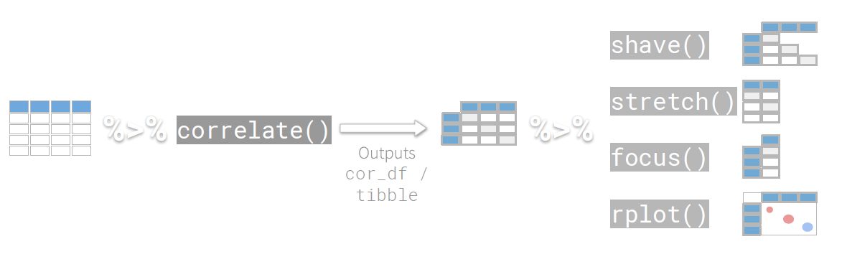
corrr package
https://rstudio.com/resources/webinars/modeling-in-databases-with-r/

Slide 47
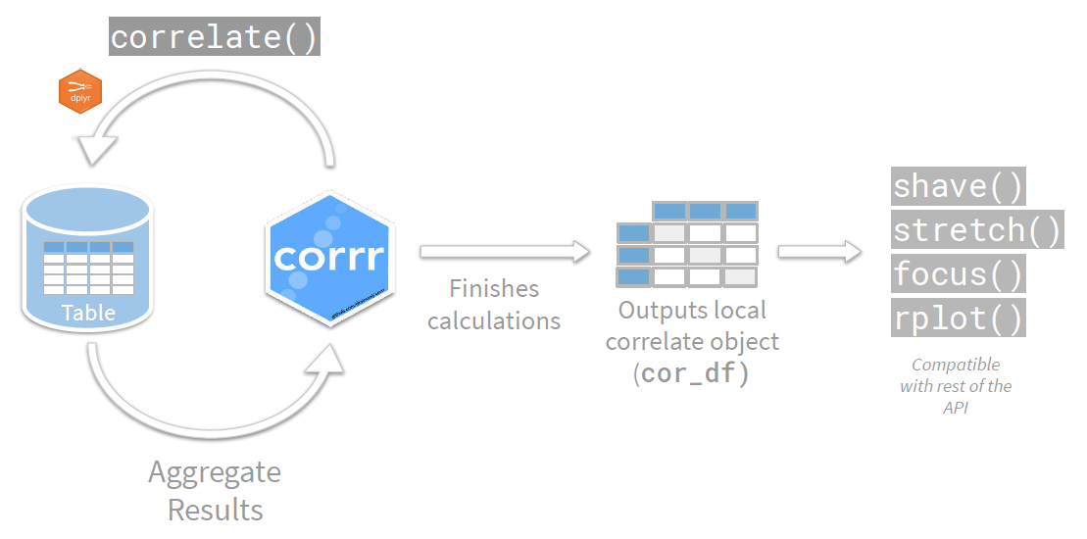
corrr database integration
https://rstudio.com/resources/webinars/modeling-in-databases-with-r/

Slide 48
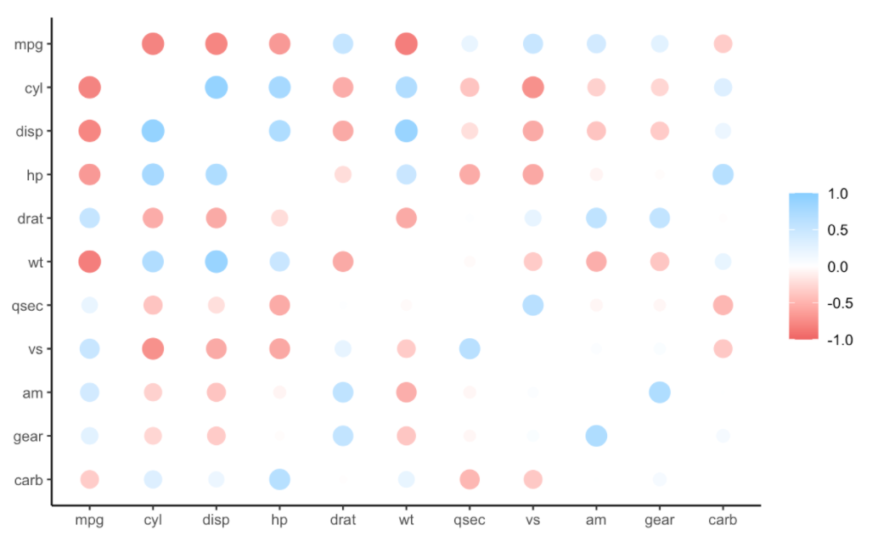
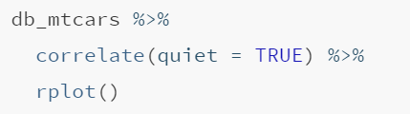
corrr example
https://corrr.tidymodels.org/

Slide 49
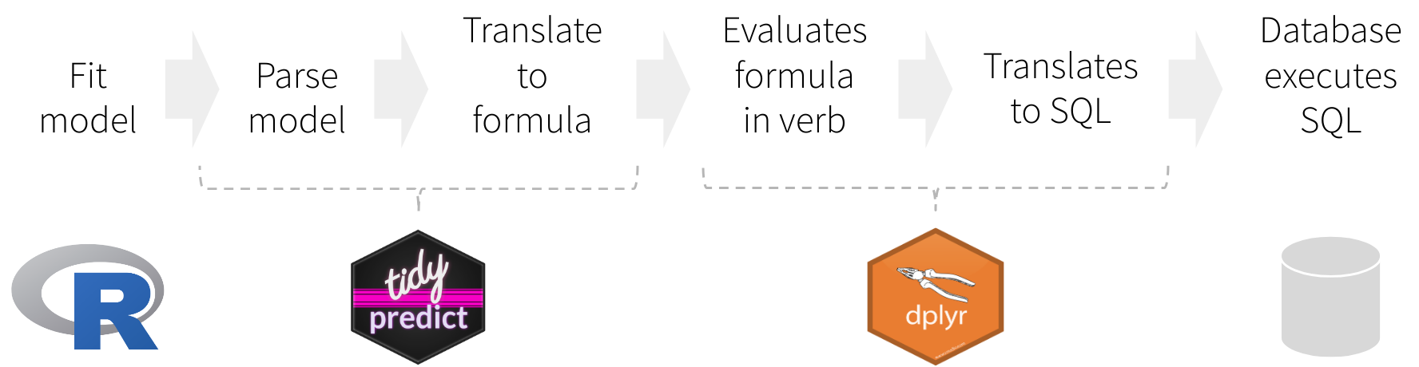
tidypredict
https://tidypredict.tidymodels.org/

Slide 50
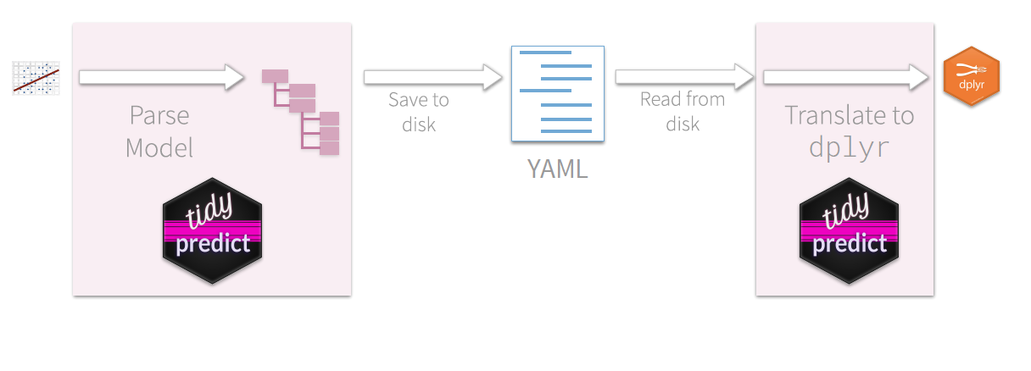
Saving the parsed model
https://rstudio.com/resources/webinars/modeling-in-databases-with-r/

Slide 51
tidypredict example (after having built model)
update_statement <- build_sql("UPDATE flights_table SET current_score = ", tidypredict_sql(model, con = con), con = con)
update_statement #> <SQL> UPDATE flights_table SET current_score = -3.5984422918702 + (`hour` * 1.38710560882252) + (`distance` * -0.00307606912118567)
SQL statements for models like xgboost or random forests make for VERY LONG SQL statements
https://tidypredict.tidymodels.org/

Slide 52
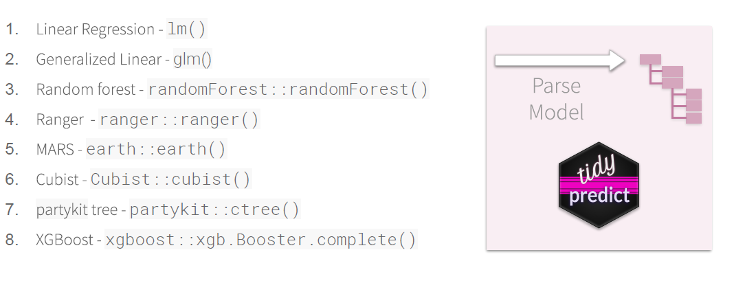
tidypredict models supported
https://rstudio.com/resources/webinars/modeling-in-databases-with-r/

Slide 53
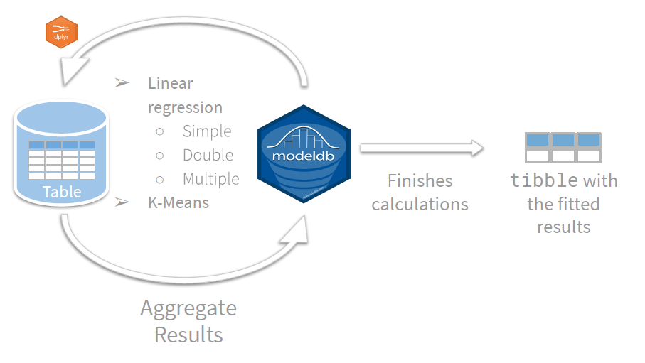
modeldb estimates the model in the database
https://rstudio.com/resources/webinars/modeling-in-databases-with-r/

Slide 54
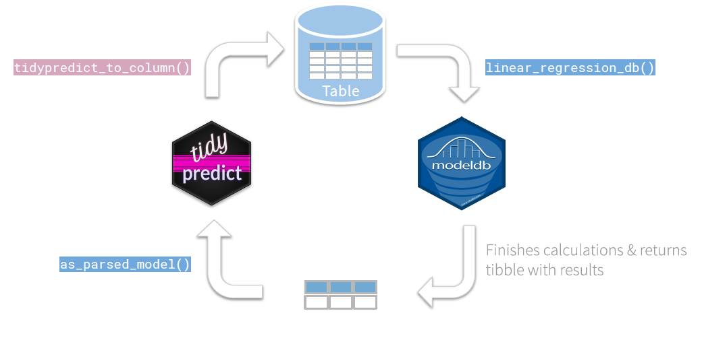
modeldb + tidypredict
https://rstudio.com/resources/webinars/modeling-in-databases-with-r/

Slide 55

Some important notes
Not all of R is supported, mostly just `dplyr` and things that are able to run on `dplyr`
SQL functions (that don’t exist in R) can still be run within dplyr verbs
See https://db.rstudio.com/ for best practices and details on security
Did not cover all relevant packages:
sparklyr (and production pipelines, etc.)
rsparkling
dm (data model)
tidyquery
rjdbc
…

Slide 56
References:
https://rstudio.com/resources/webinars/best-practices-for-working-with-databases/ (see associated link to github for presentation materials)
https://github.com/edgararuiz/big-data-w-r
https://rstudio.com/resources/webinars/modeling-in-databases-with-r/ (see associated link to github for presentation materials)
https://rstudio.com/resources/rstudioconf-2019/databases-using-r-the-latest/ (see associated link to github for presentation materials)
https://db.rstudio.com/
https://corrr.tidymodels.org/
https://tidypredict.tidymodels.org/
https://edgararuiz.github.io/dbplot/
https://therinspark.com/
https://r4ds.had.co.nz/
Data Scientist at NetApp
Bryan Shalloway
@brshallo
www.bryanshalloway.com/

Slide 57
Appendix

